Slide 1


Using Twitter to Predict Box Office Performance
Xuewei Du
Haikun Du
Chi Zhang
Yigang (Jack) Wang

Slide 2
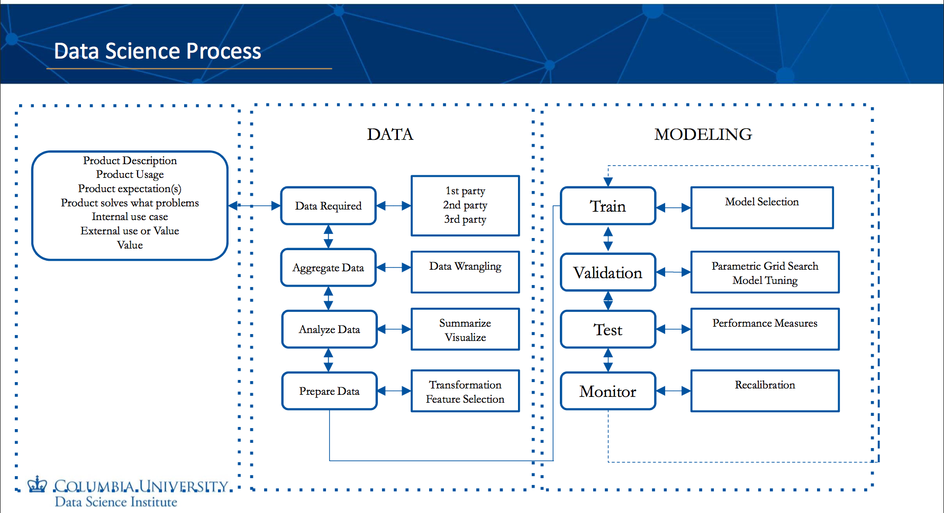

Slide 3
Outline
· Introduction
· Methodology
· Current Work
· Future Work
· Q & A

Slide 4
Introduction

Slide 5
Problem Statement
Tweets can reflect the box office performance of a specific movie!

Slide 6
Methodology

Slide 7
Solution
Box Office Performance Prediction
5
Classifier
4
Sentiment Analysis
3
Feature
Extraction & Selection
2
Data Acquisition & Exploratory Analysis
1

Slide 8
Packages & Steps
Use google and tweepy to gather twitter data
Use pymongo to store data in local computer
Use nltk to extract features and to analyze sentiment
Use Tableau to visualize result
Use sklearn to train the classifier model
Use pickle to save trained models
Use sklearn to predict future Box-Office

Slide 9
Current Work
Data Acquisition and Exploratory Data Analysis
Feature Extraction
Sentiment Analysis

Slide 10
Current Work
Data Acquisition and Exploratory Data Analysis

Slide 11
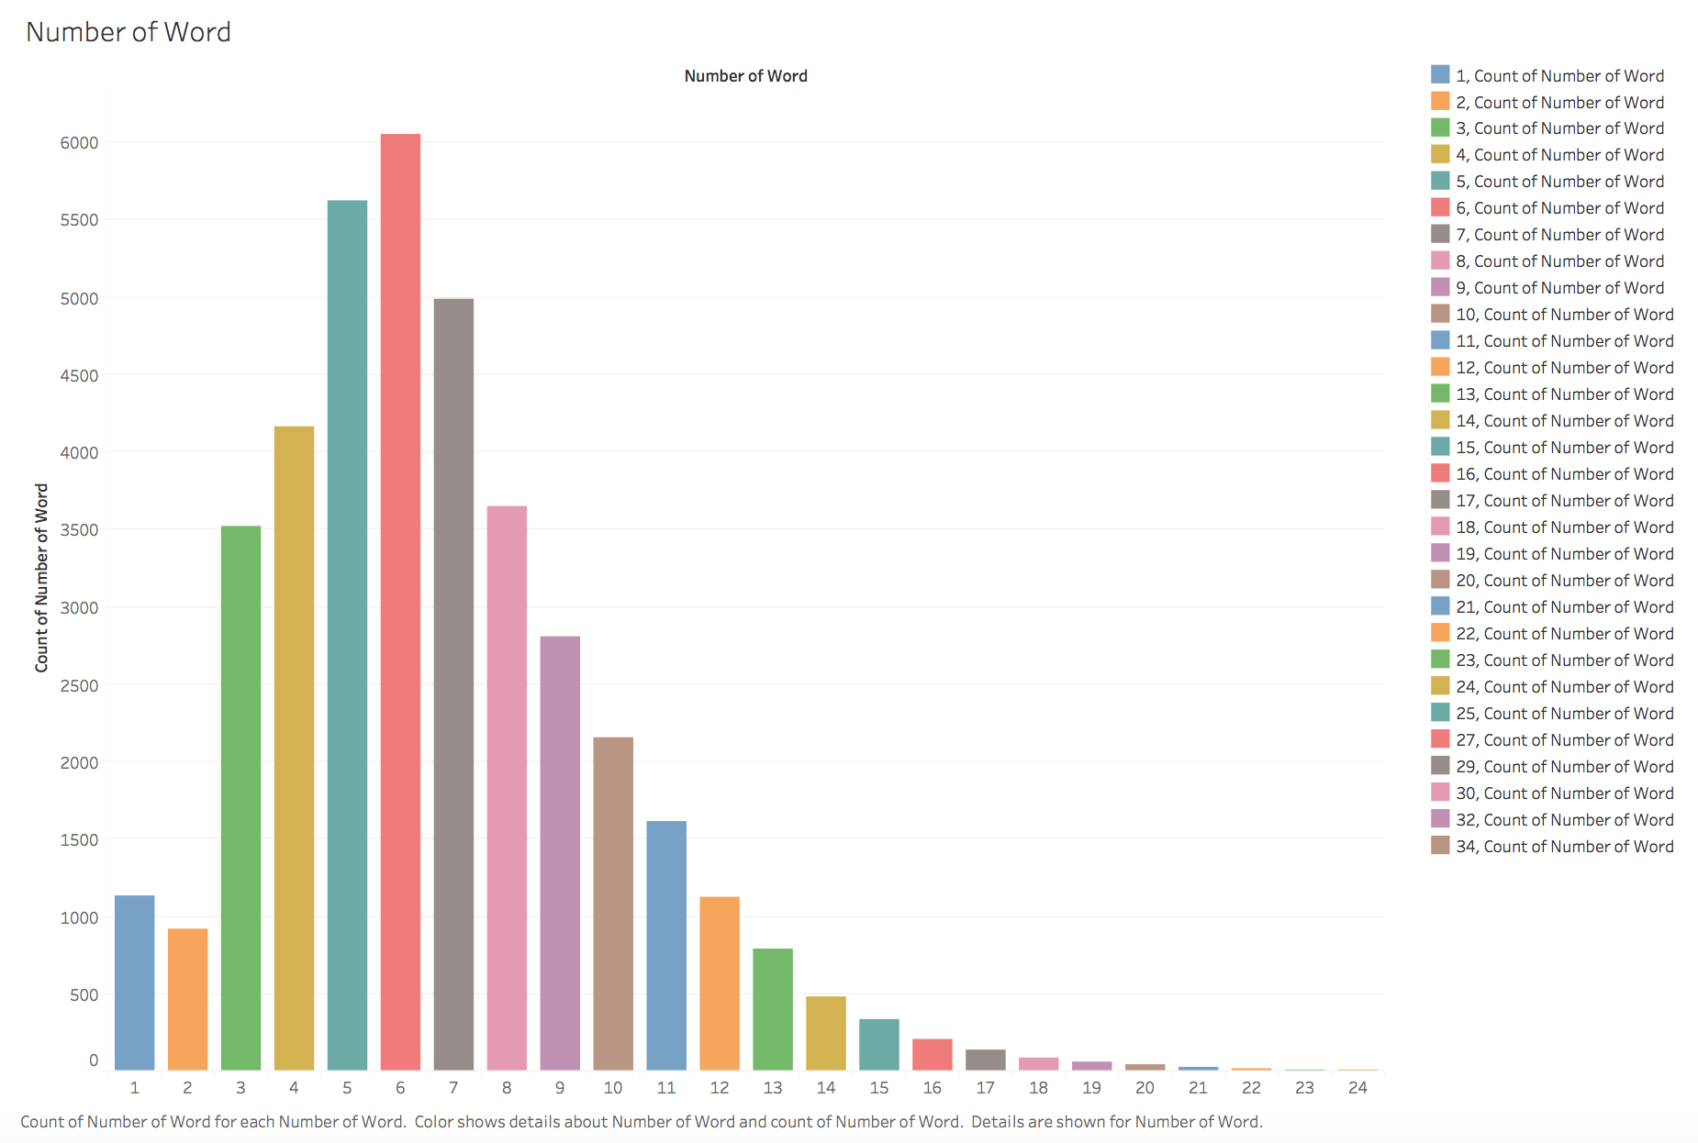
Data Acquisition and Exploratory Data Analysis
Tweet
Length

Slide 12
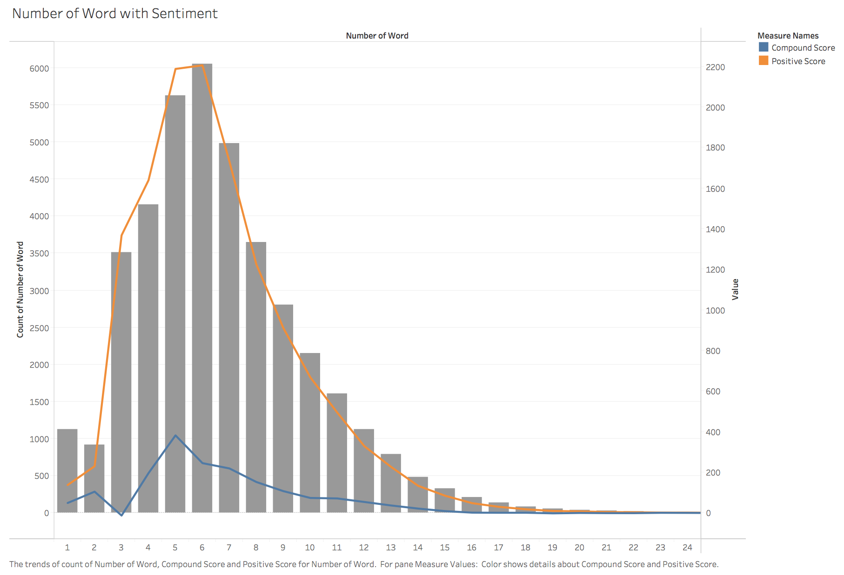
Data Acquisition and Exploratory Data Analysis
Tweet
Length

Slide 13
Current Work
Data Cleaning
Eliminate non-English words, some punctuation marks and stopwords, etc.

Slide 14
How a tweet influence a movie’s box office?
Current Work
Feature Extraction

Slide 15
Feature Extraction
Feature Extraction
Chop twitter texts into single words.
Compute the occurrence frequency of unigrams and bigrams in twitter reviews.
Use TF -IDF method to evaluate how important a word is in a document and select top 1000 words with the highest frequency.

Slide 16
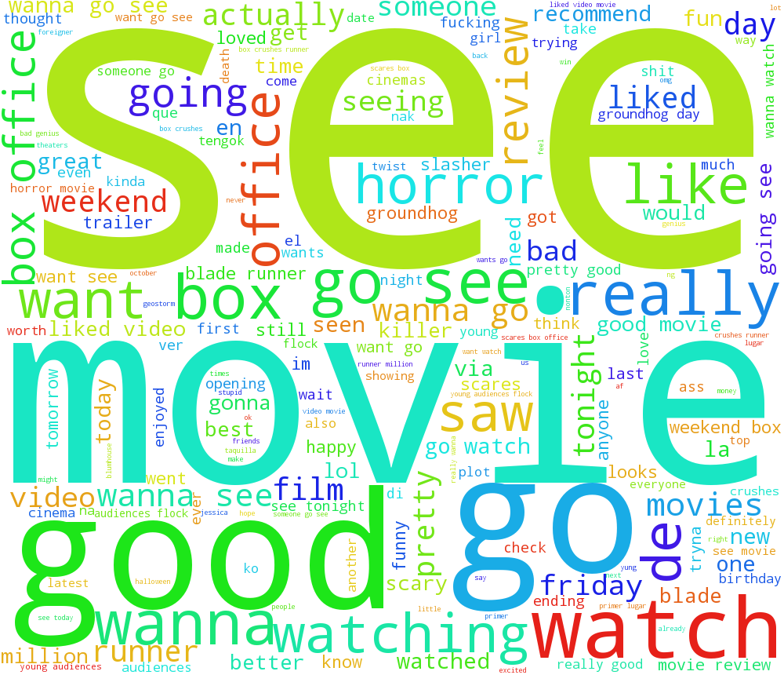
Feature Extraction
Word Cloud

Slide 17
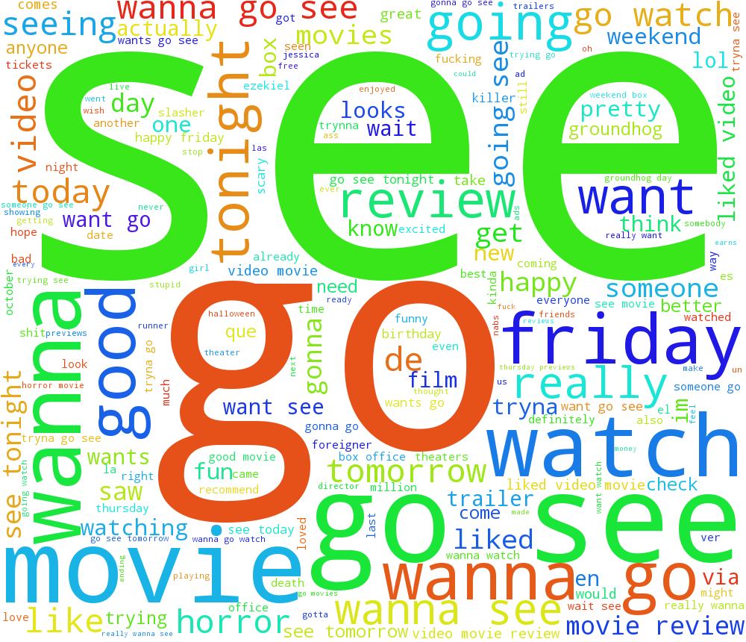
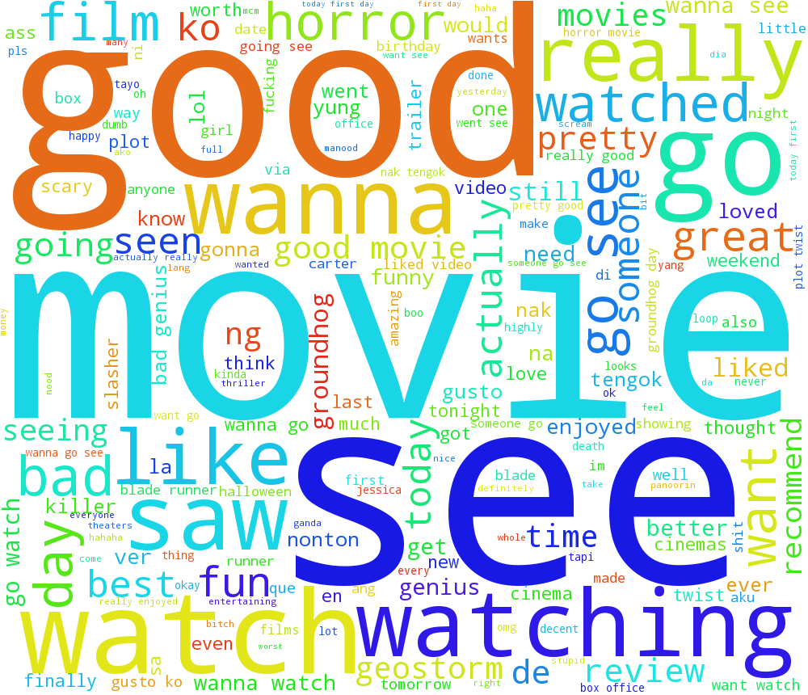
Feature Extraction
Changes of twitter topics
2017/10/13
2017/10/22

Slide 18
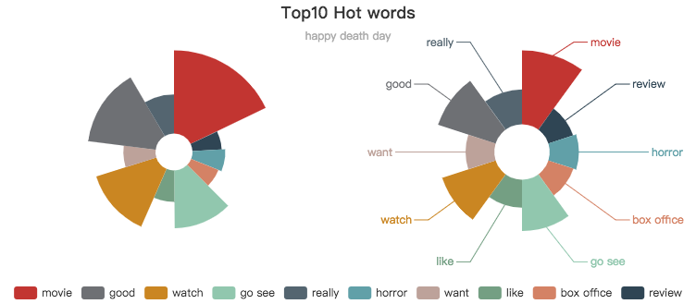
Feature Extraction
Hot features
http://gallery.echartsjs.com/editor.html?c=xSyqx4IL0Z&v=1
password：22vXK5

Slide 19
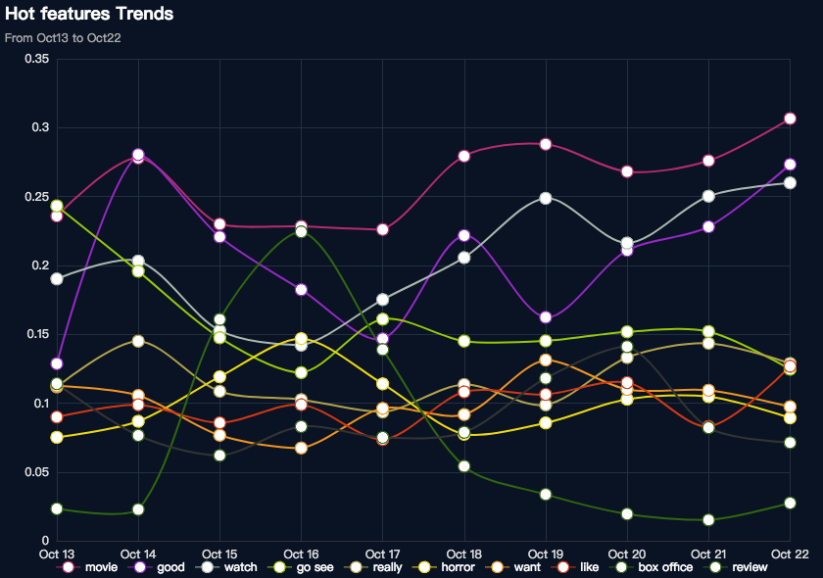
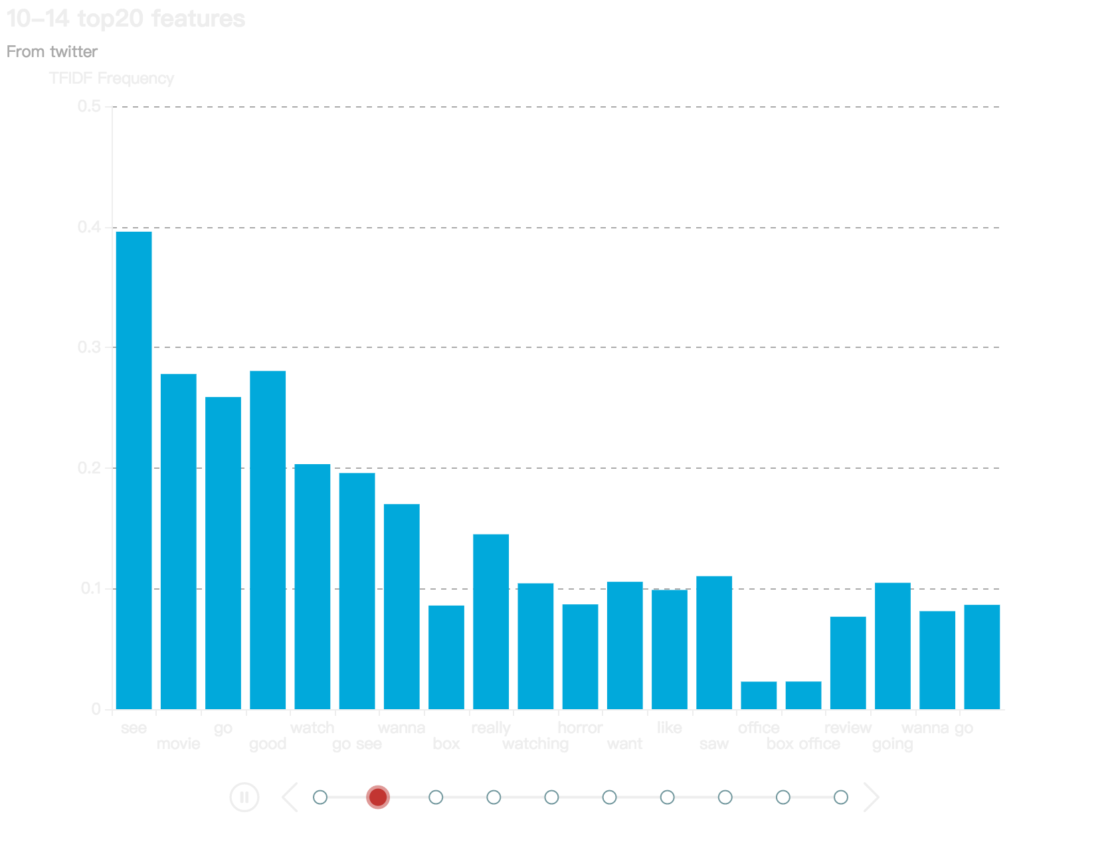
Feature Extraction
Top 20 features Trends
http://gallery.echartsjs.com/editor.html?c=xBytH7PHAW&v=1
Password：vgKkCF
http://gallery.echartsjs.com/editor.html?c=xBJopNH8Cb&v=1
Password：BcDu6K

Slide 20
Current Work
Sentiment Analysis

Slide 21
Sentiment Analysis
Use SentimentIntensityAnalyzer() from NLTK
Based on lexicons of sentiment-related words
Word | Sentiment Rating
good | 1.9
great | 3.1
tragedy | -3.4
insane | -1.7

Slide 22
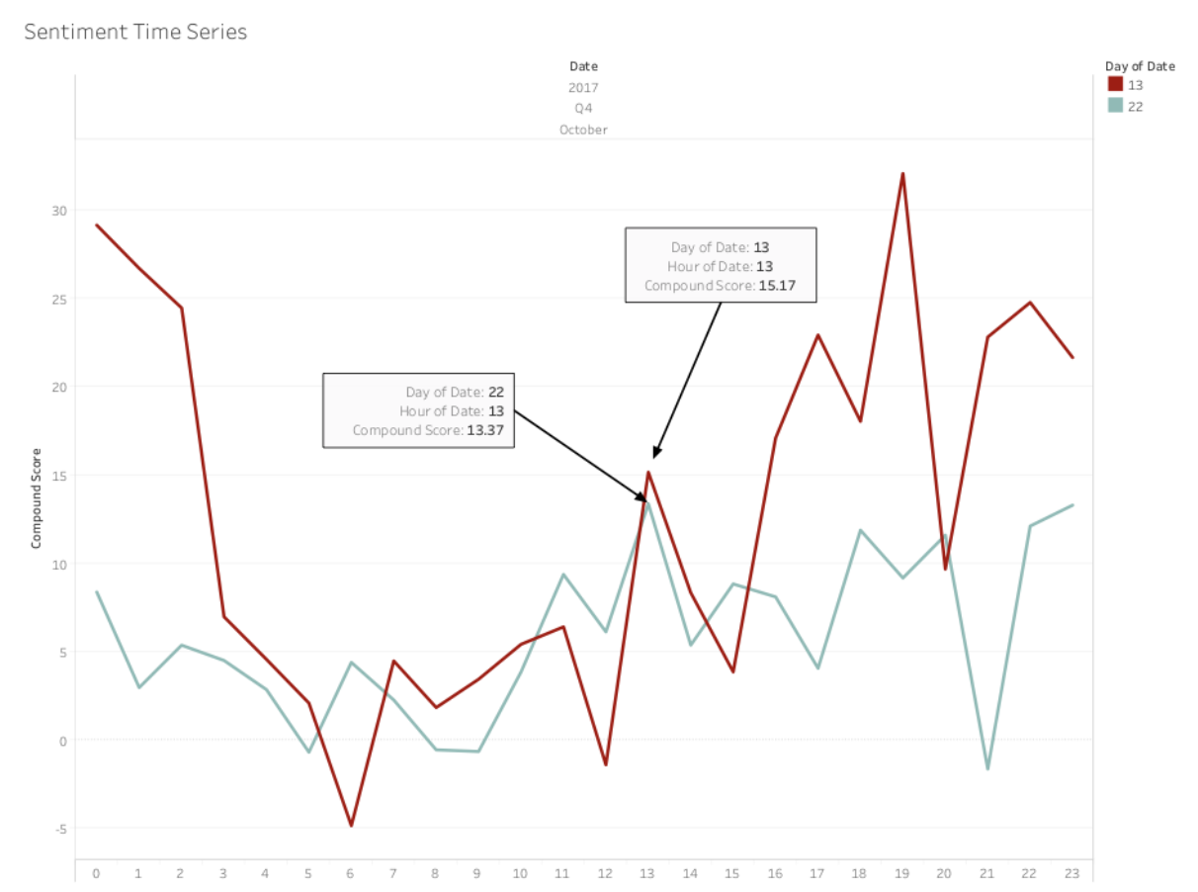
Sentiment Analysis
Sentiment Changes
Over 24h
1

Slide 23
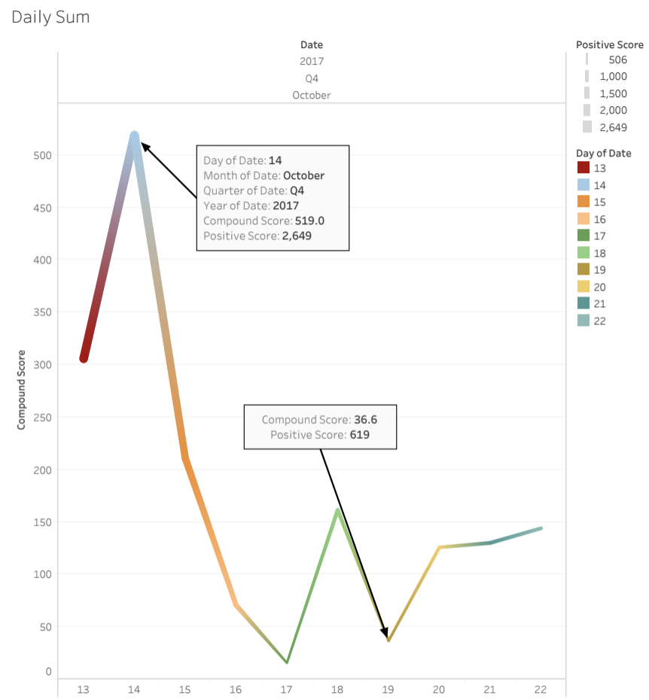
Sentiment Analysis
Sentiment Changes
Over First 10 Days
1

Slide 24
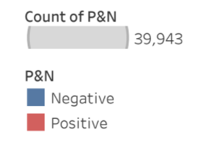
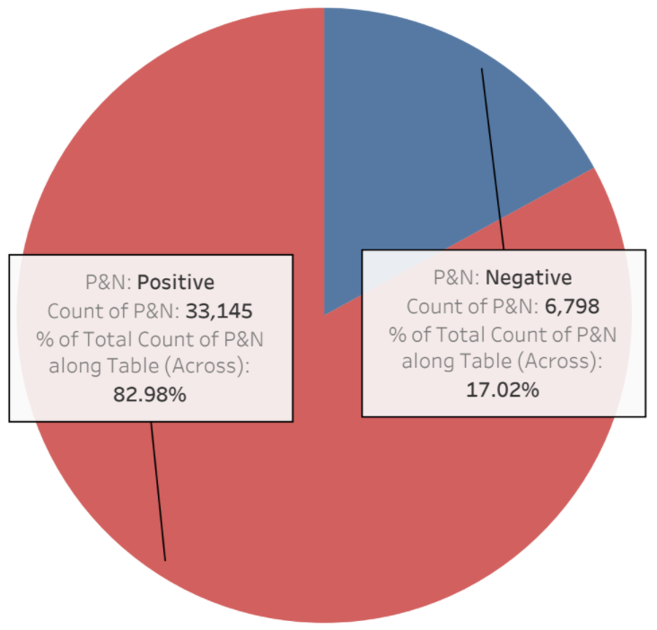
Sentiment Analysis
Total Positive vs Total Negative
1

Slide 25
Future Work
Classifier
Box Office Performance Prediction

Slide 26
What next?
Obtain daily Box-Office data
Train the model with historical Box-Office data and sentiment result
Future Box-Office performance prediction
Apply the streamline process from HW3 to classify movies
Generalizing prediction result to 300+ movies

Slide 27
Timeline - Revisit

Slide 29
Q & A

Slide 30
Citation:
Slide 1. Happy Death Day. Adapt from “Happy Death Day,” by Nick Spake, 2017, retrieved from https://images.flickreel.com/wp-content/uploads/2017/10/HappyDeathDay-Featured-01-1200x675.jpg
Slides 4 & 29. Data Science Process. Adapted from "Projects in Data Science," by Houlihan, 2017, retrieved from https://courseworks2.columbia.edu/courses/48086/files?preview=1523634

